Slide 1

Student Details
Name : Jaswanth Kavuri
Skills build email id : jaswanthkavuri8@gmail.com
College name : SRK INSTITUTE OF TECHNOLOGY
College State : Andhra Pradesh BRANCH:INFORMATION TECHNOLOY
Artificial Intelligence and Machine Learning
June 7th to July 12th

Slide 2
PROJECT TITLE
Employee Burnout Rate
Using
Machine Learning

Slide 3
AGENDA
INTRODUCTION
Who are the end users of this project ?
Your solution and its value proposition
How did you customize the project and make it your own
Modelling
Results

Slide 4
PROJECT OVERVIEW (Introduction)
Employee burnout is a state of physical, emotional and mental exhaustion caused by excessive and prolonged stress. It can have serious consequences on an individual's well-being and can lead to decreased productivity and job performance. In today's fast-paced and constantly connected world, it is increasingly important to recognize and address the signs of burnout in order to maintain the health and well-being of employees.
This analysis aims to delve deeply into the multifaceted dimensions of employee burnout. We will explore its underlying causes, manifestations, impact on productivity, and implications for organizational health. By examining the latest research, real-world case studies, and expert insights, we seek to uncover the nuanced factors contributing to burnout across different industries and job roles.

Slide 5
WHO ARE THE END USERS of this project?
Edunet Foundation is the end users of this project this prediction can be useful for this company

Slide 6
YOUR SOLUTION AND ITS VALUE PROPOSITION
Decision Tree Regression Models:
Decision trees are a type of supervised learning algorithm that can be used for regression tasks.
Decision tree models are interpretable and can handle both numerical and categorical data.
Applying Decision Trees to Burnout Prediction:
Data Collection: Gather relevant data, including features related to work conditions, stress levels, and individual characteristics.
Feature Selection: Choose relevant features (e.g., workload, job satisfaction, sleep quality) to build the model.
Model Training: Train a decision tree regression model using historical data on burnout cases.
Model Evaluation: Assess the model’s performance using metrics like Mean Absolute Error (MAE) or Root Mean Squared Error (RMSE).
Prediction: Use the trained model to predict burnout levels for new employees.
Benefits of Decision Tree Models:
Interpretability
Feature Importance
Visual Representation

Slide 7
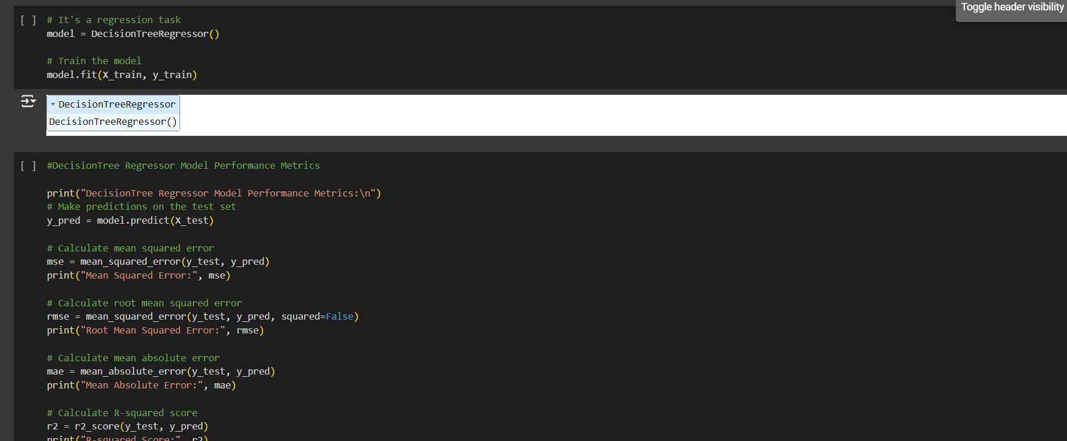
How did you customize the project and make it your own
Instead of Linear Regression model ,I have used Decision Tree Regression model to give the more accurate results

Slide 8
MODELLING
Got the data from the online site.
Uploaded the data.
Understand the data using the function like Head, Tail etc.
Preprocess the data finding null values.
Understand the Co relation.
Do the visualization.
Did the Decision Tree Regression Model Building.

Slide 9
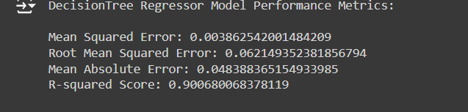
Results

Slide 10
links
https://docs.google.com/presentation/d/1BX469ggQCa5rYMfPY1k6syVR-QZJ_dz6/edit?usp=drivesdk&ouid=102466609869612083630&rtpof=true&sd=true

